Slide 1








Data integration in Bgee
Frederic Bastian
BC2 2025 tutorial: The Bgee suite
@bgeedb@genomic.social
@bgee.org

Slide 2

Data standardization
https://www.bgee.org/
Example using scRNA-Seq data

Slide 3

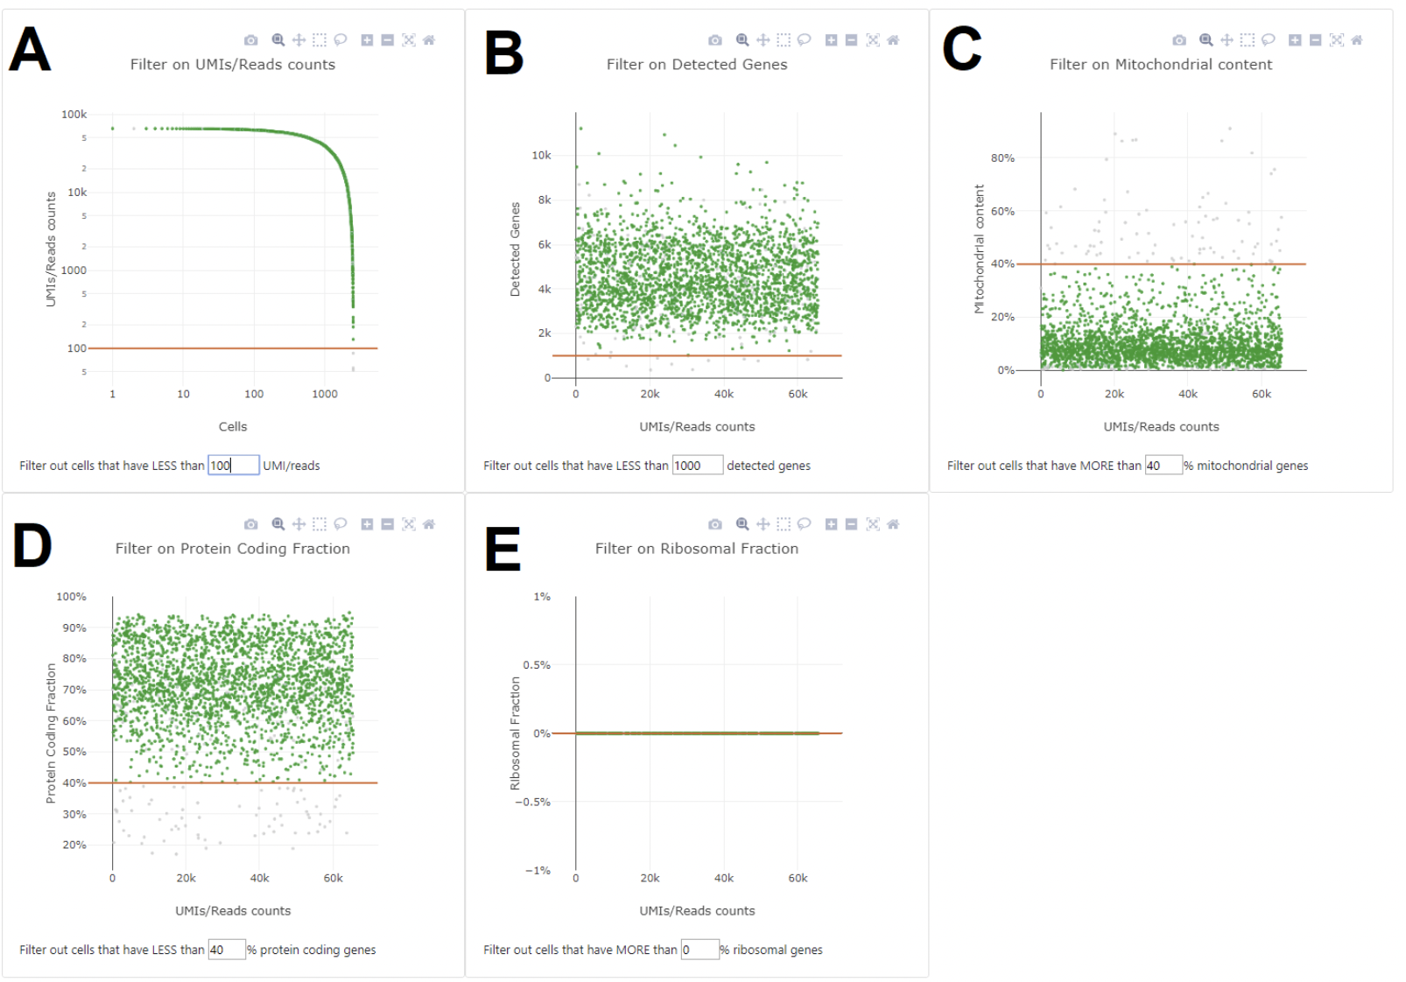
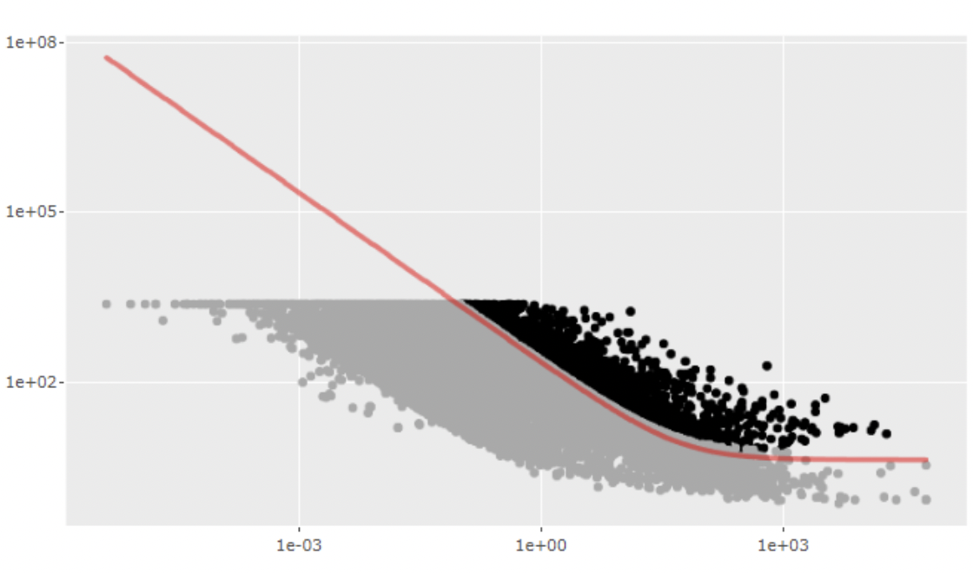
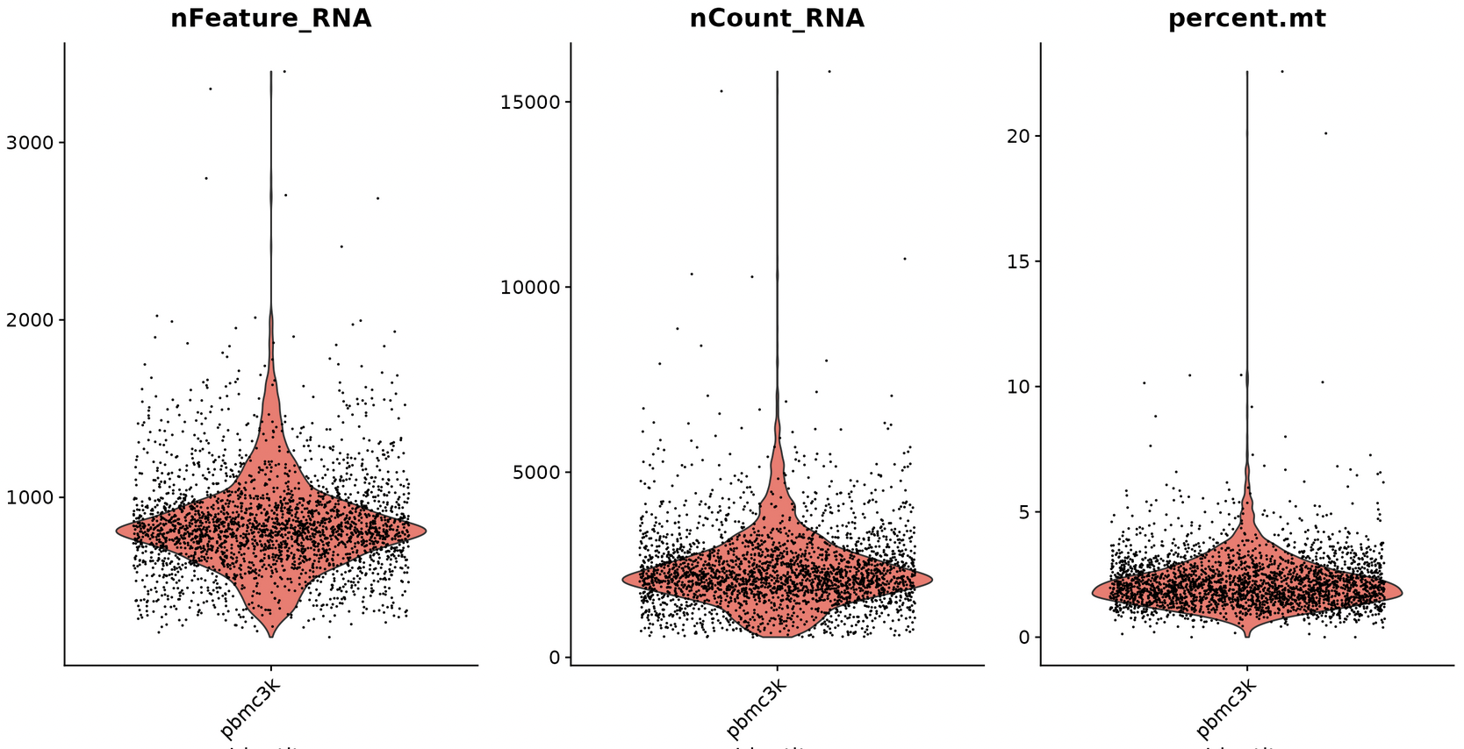
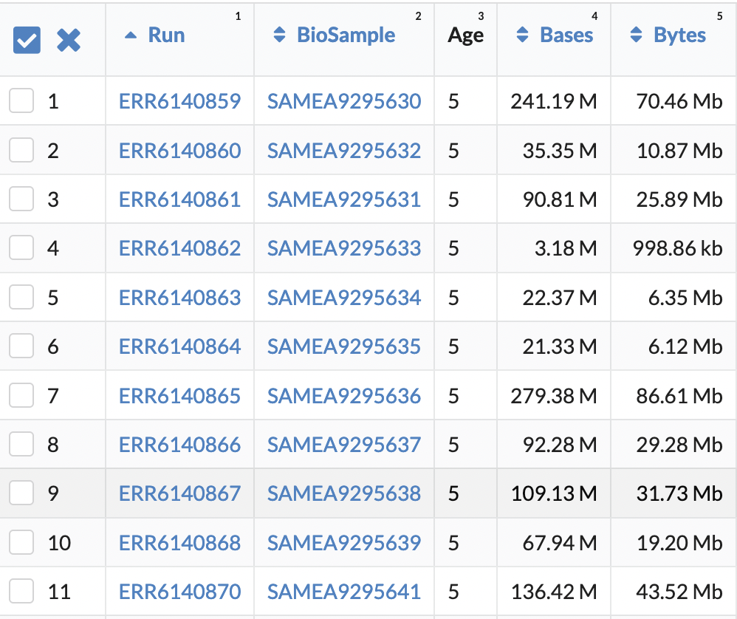
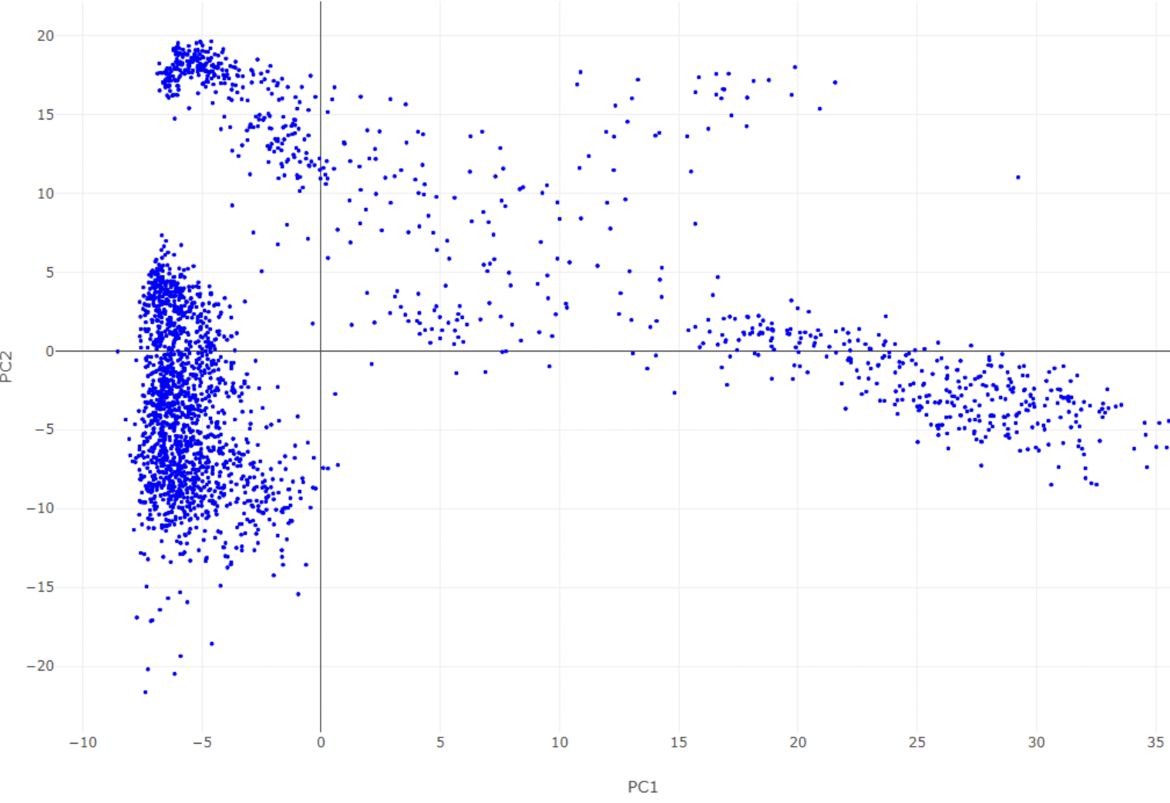
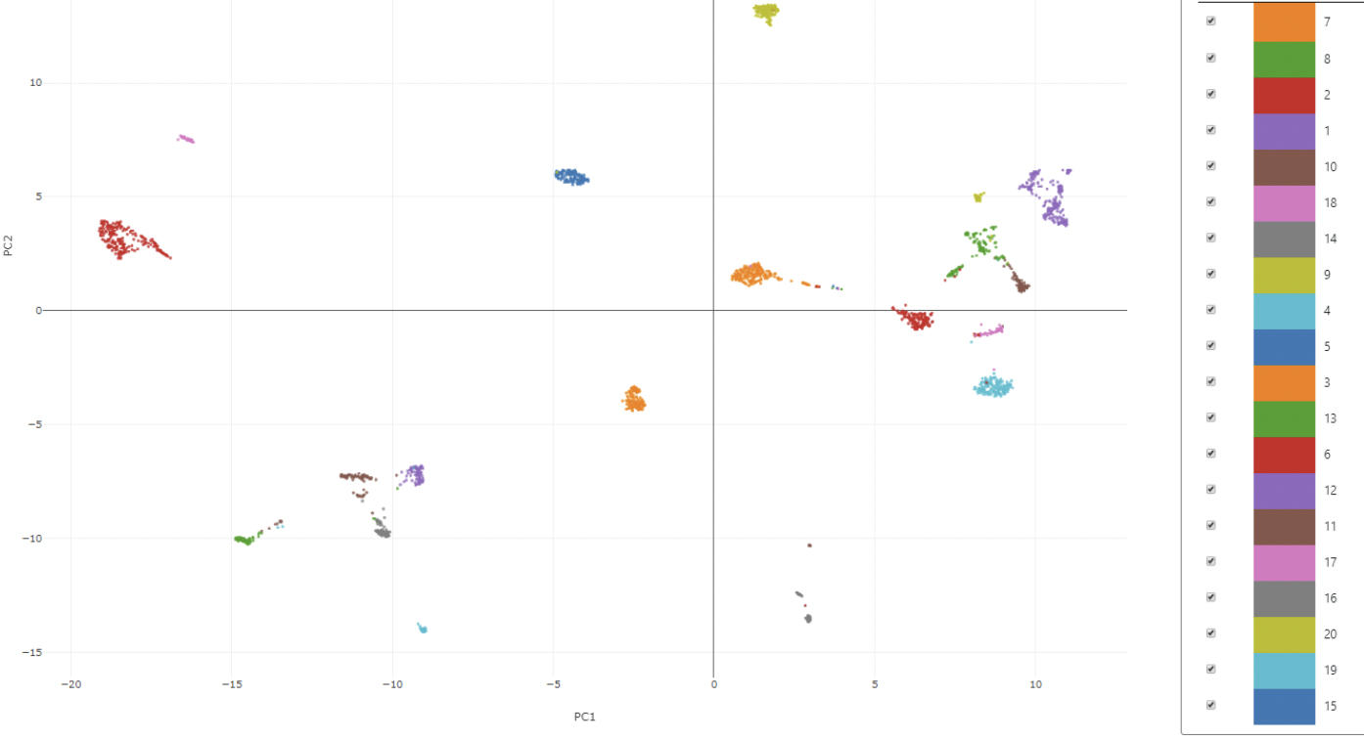
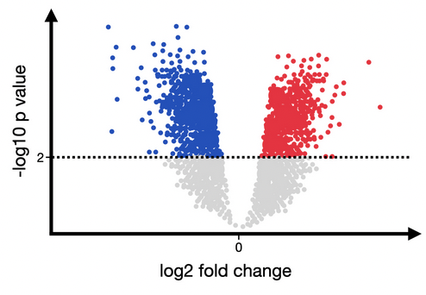
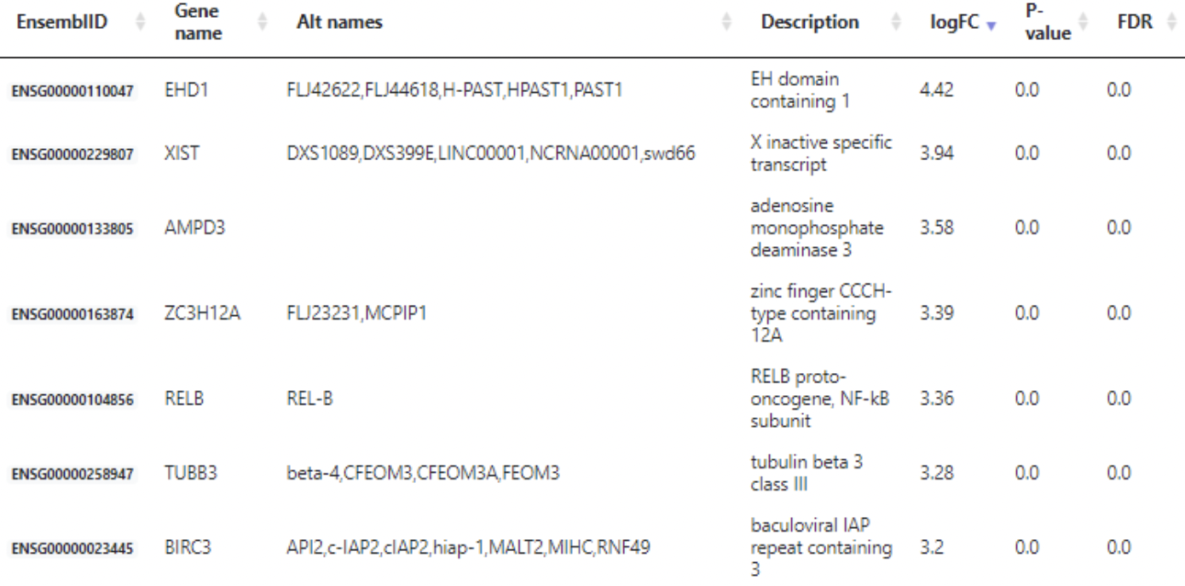
Added complexity of scRNA-Seq data
1) Access raw data
2) Cell filtering
3) Gene filtering
4) Normalization, scaling
6) Dim. reduction
7) Cell clustering
8) Diff. expression
9) Functional enrichment
Cell type assignment
https://asap.epfl.ch/home/tutorial?t=full_pipeline

Slide 4
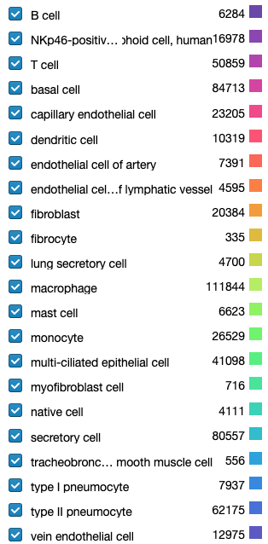
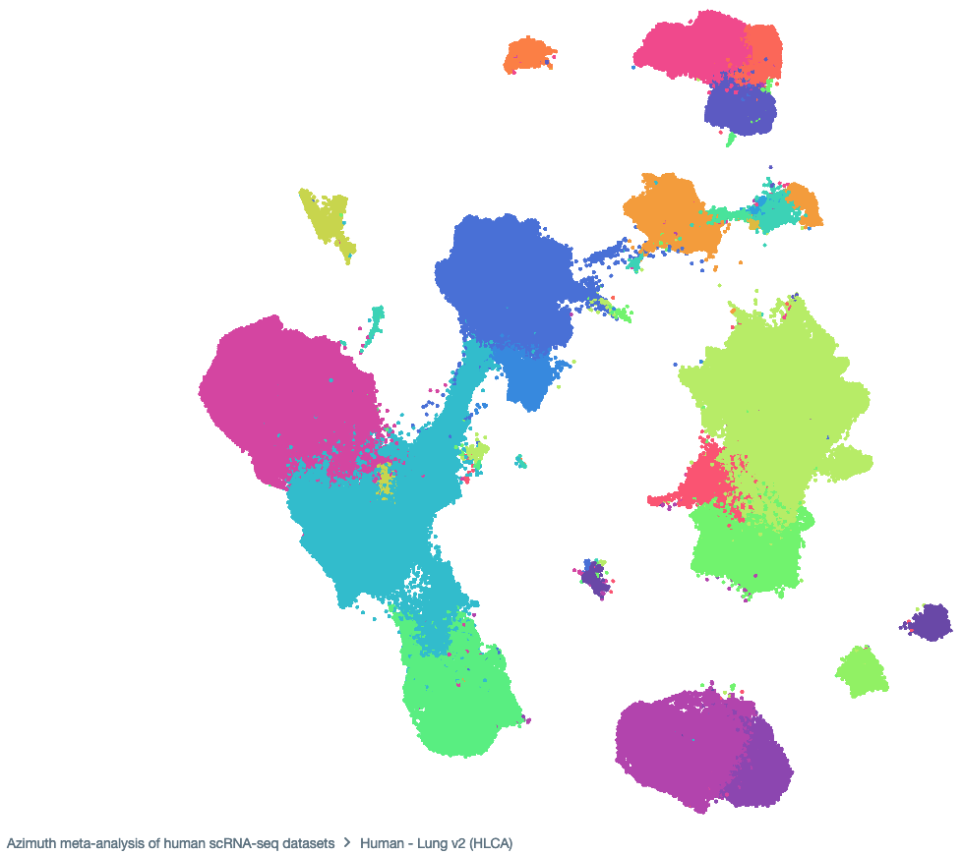
scRNA-Seq result visualization

Slide 5
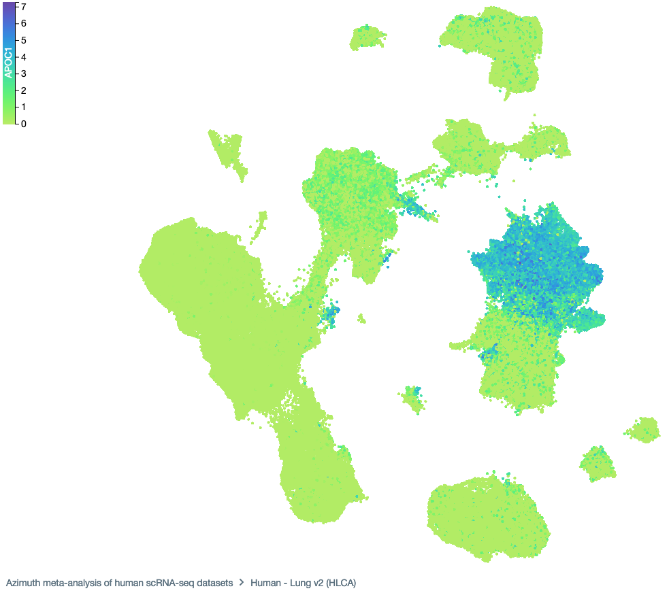
scRNA-Seq result visualization

Slide 6
Challenges in standardized dataset annotation
Data processing depends on protocol used, e.g.:
Single nuclei vs. single cell
Barcode and UMI positions
Annotation depend on clustering
In FCA, some cells annotated:
“ovary cell” in stringent clustering
“neuron” in broad clustering
Problems for reproducible analyses:
to access barcode files
to associate barcodes to annotated clusters
to access BAM/FASTQ files
Notes:
Shooting at FCA, sorry, just because the data were widely available: Thank you to FCA for providing all these data, it’s always easy to critisise. Also, maybe WE are in errors for some of these points. We just want to highlight the challenges. Blablabla, be nice :p
Inconsistency “stringent”/”broad” annotations: different criteria of clustering

Slide 7
Challenges in standardized dataset annotation
Do the read alignment to transcriptome
(needs library protocol)
Unprocessed raw data
Gene expression count for each cell
Do the clustering
Coordinates of each cell in the clustering plot
Association between cell barcodes and clusters
Cell type information for each cell
Cell type information for each cluster

Slide 8
In Bgee
Do the read alignment to transcriptome
Unprocessed raw data
Advantage: up-to-date genomes
Gene expression count for each cell
Do the clustering
Advantage: doesn’t misrepresent authors’ data
Association between cell barcodes and clusters
Cell type information for each cell
Cell type information for each cluster

Slide 9
Gene expression calls
https://www.bgee.org/
Detecting the conditions where a gene is active

Slide 10
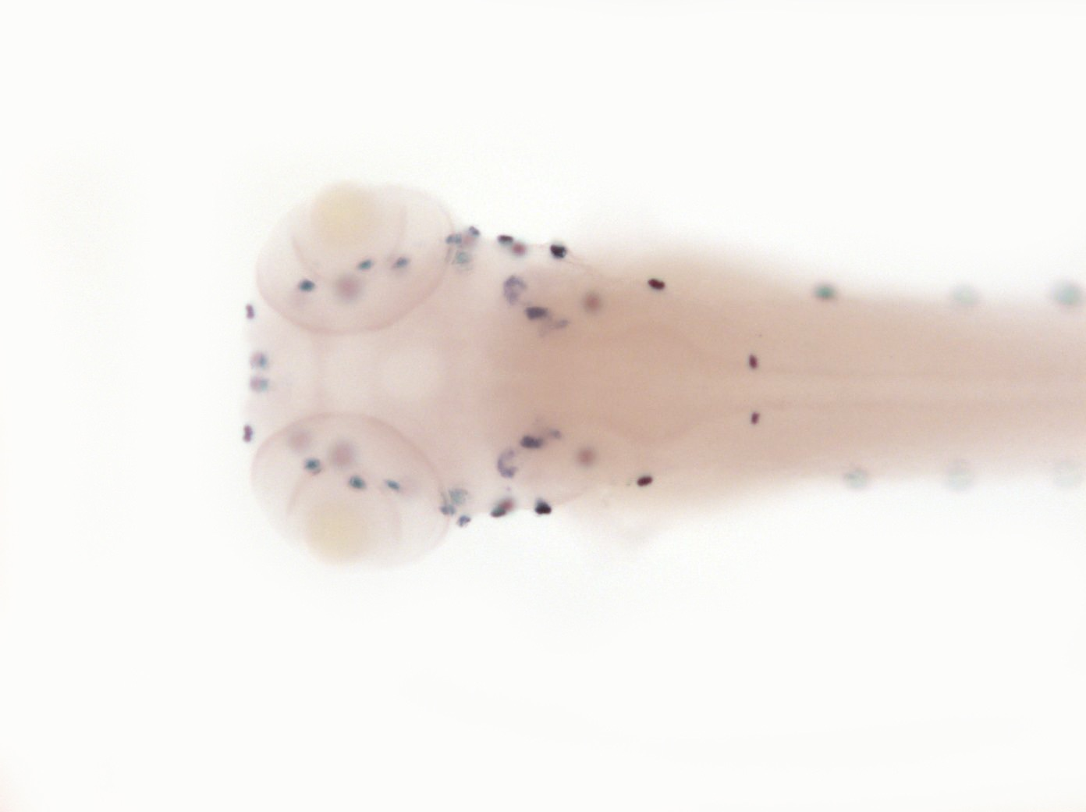

Detecting gene expression

Slide 11
Detecting gene expression
Important to detect active signal of expression:
For filtering non-expressed genes before, e.g., differential expression analyses
For studies of condition-restricted genes, e.g. sex-biased genes
Simply, for answering the question : “where is this gene expressed?”
Notes:
Variety of techniques for studying gene expression
The point, with all those techniques, at some point you detect some expression of your genes. But does it mean that this gene is actively expressed? How do we distinguish from technical and transcriptional noise?
=>but above what expression value do you consider it's actively expressed?
=> how to manage variations between different conditions, e.g. same organ but different sexes, or strains, or disease state, or environmental conditions, etc?
=> for this you should have technical replicates, but hey, not all experiments are perfect, some are cost-limited, or some samples failed, etc.

Slide 12
Detecting gene expression
How do you determine whether a gene is expressed?
over background stochastic transcriptional noise
over technical random and non-random noise
Notes:
Variety of techniques for studying gene expression
The point, with all those techniques, at some point you detect some expression of your genes. But does it mean that this gene is actively expressed? How do we distinguish from technical and transcriptional noise?
=>but above what expression value do you consider it's actively expressed?
=> how to manage variations between different conditions, e.g. same organ but different sexes, or strains, or disease state, or environmental conditions, etc?
=> for this you should have technical replicates, but hey, not all experiments are perfect, some are cost-limited, or some samples failed, etc.

Slide 13
Expression calls from RNA-Seq data
https://www.bgee.org/

Slide 14
Expression calls from RNA-Seq data
To detect active expression from RNA-Seq data, most authors use an arbitrary cutoff on expression value.
But:
unlikely that one threshold could fit the variety of situations which transcriptomes can describe
little consensus on the exact value of this threshold or how it relates to sensitivity or specificity of calls
Notes:
QUESTION AFTER SLIDE

Slide 15
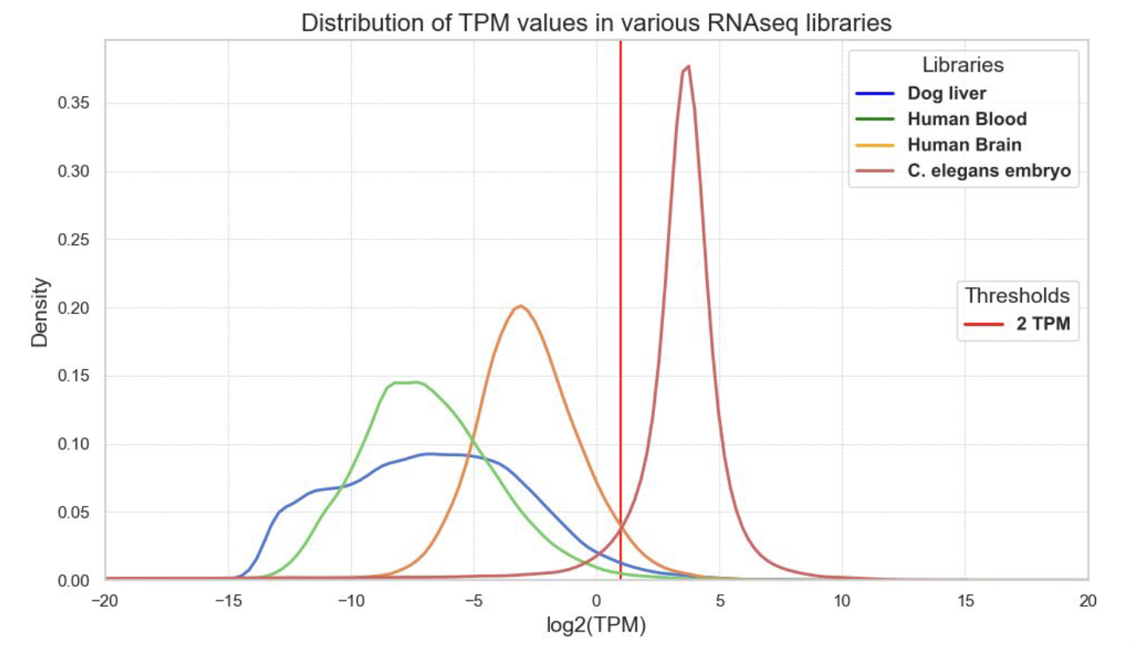
Expression calls from RNA-Seq data
Notes:
Empirical threshold of 1 RPKM or 2 TPM for calling genes actively expressed
Some studies use a threshold as little as 0.1 RPKM, or as much as 3 TPM

Slide 16
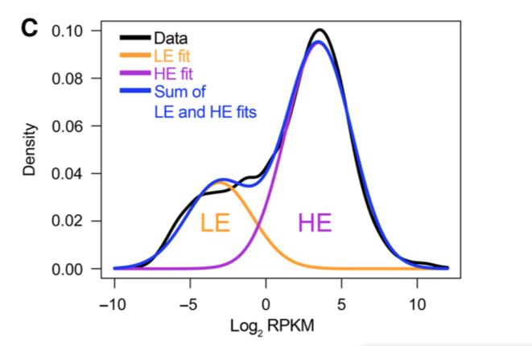
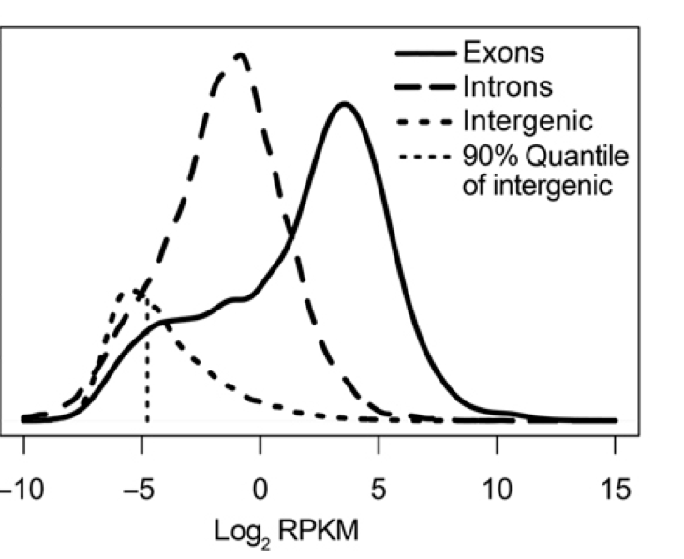
Expression calls from RNA-Seq data
Hebenstreit, et al. (2011): RNA sequencing reveals two major classes of gene expression levels in metazoan cells. Mol Syst Biol.

Slide 17
Expression calls from RNA-Seq data
Hebenstreit, et al. (2011): RNA sequencing reveals two major classes of gene expression levels in metazoan cells. Mol Syst Biol.

Slide 18
Expression calls from RNA-Seq data
Compare a gene TPM value to a distribution of non-expressed genomic features in the same library
=> Obtain a p-value

Slide 19
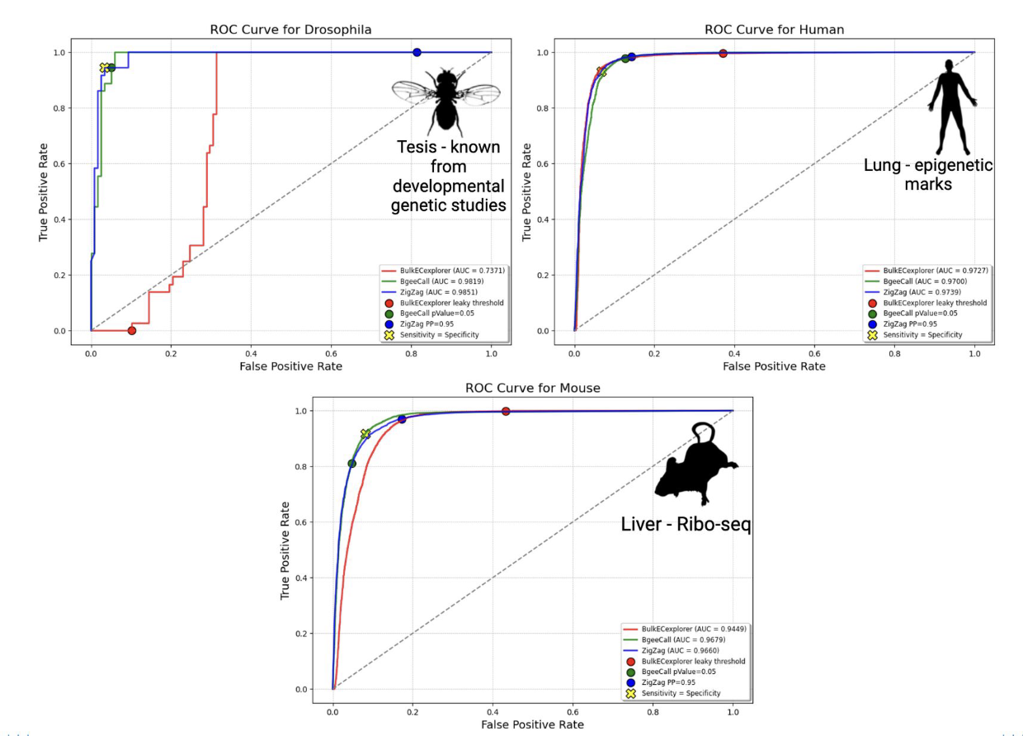
Expression calls from RNA-Seq data
Compare a gene TPM value to a distribution of non-expressed genomic features in the same library
=> Obtain a p-value

Slide 20
Single-cell RNA-Seq
https://bgee.org/

Slide 21
Single-cell RNA-Seq full-length

Slide 22
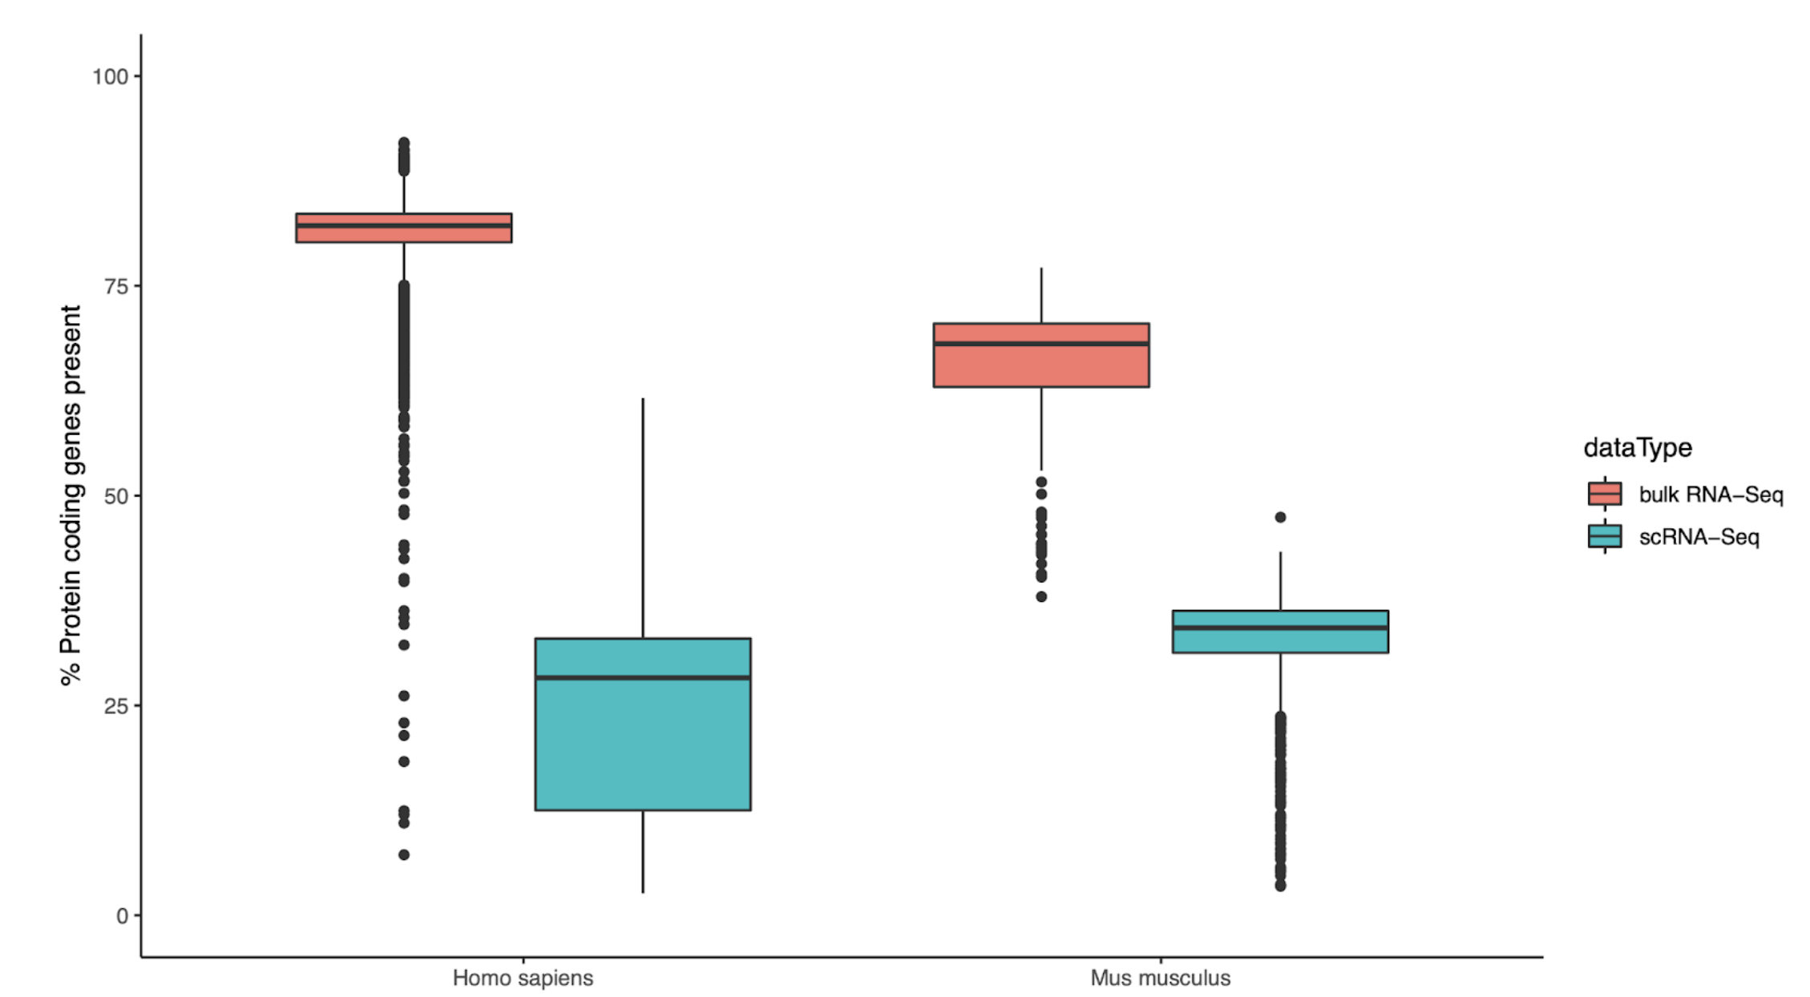
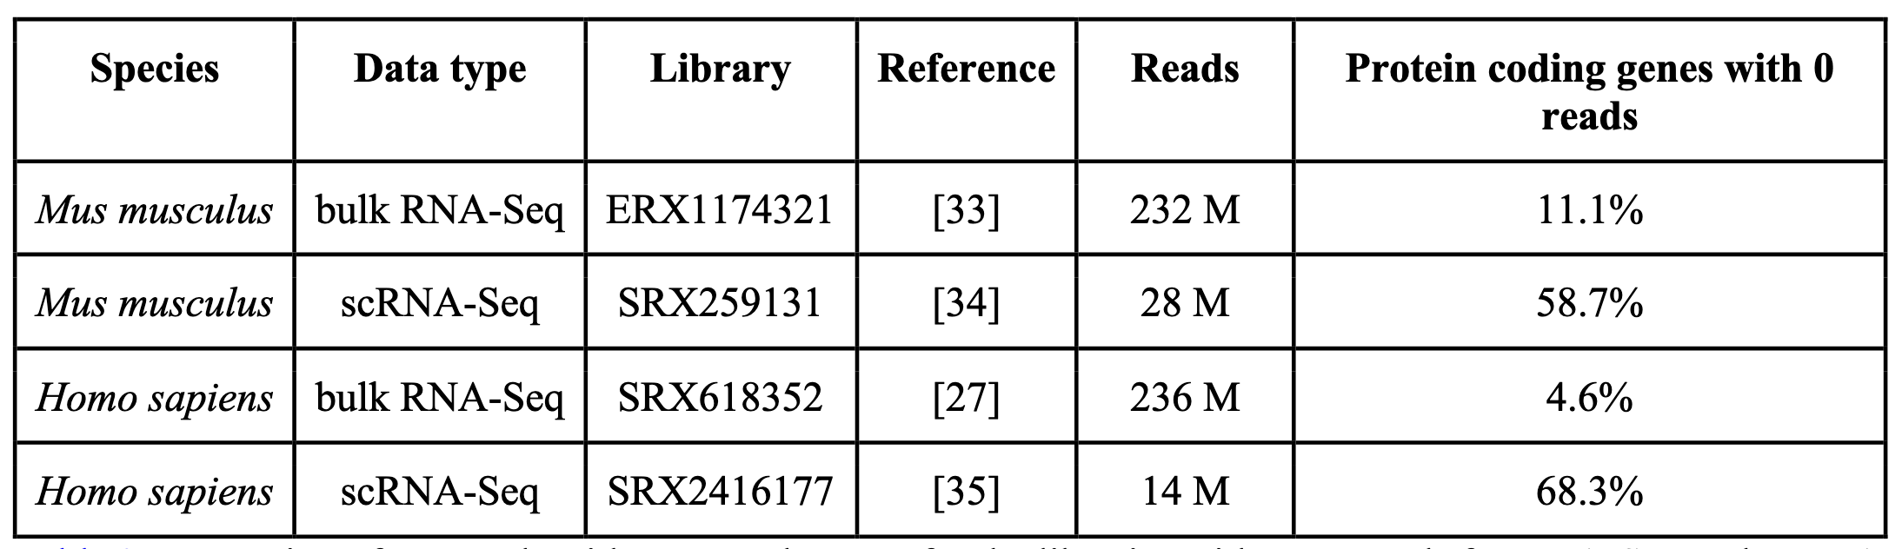
Single-cell RNA-Seq full-length
Notes:
QUESTION AFTER SLIDE

Slide 23
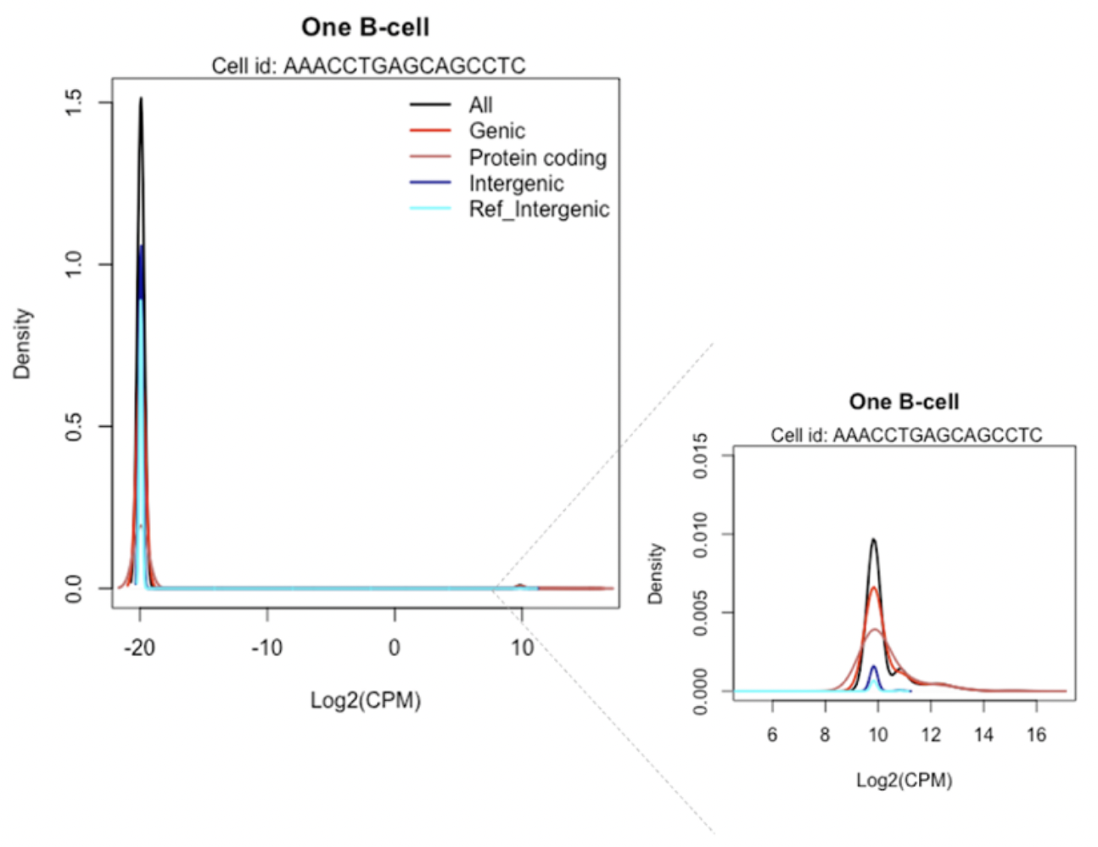
Single-cell RNA-Seq droplet-based
Droplet-based: fewer reads per cell, more drop-out
https://doi.org/10.1101/2022.03.31.486555

Slide 24
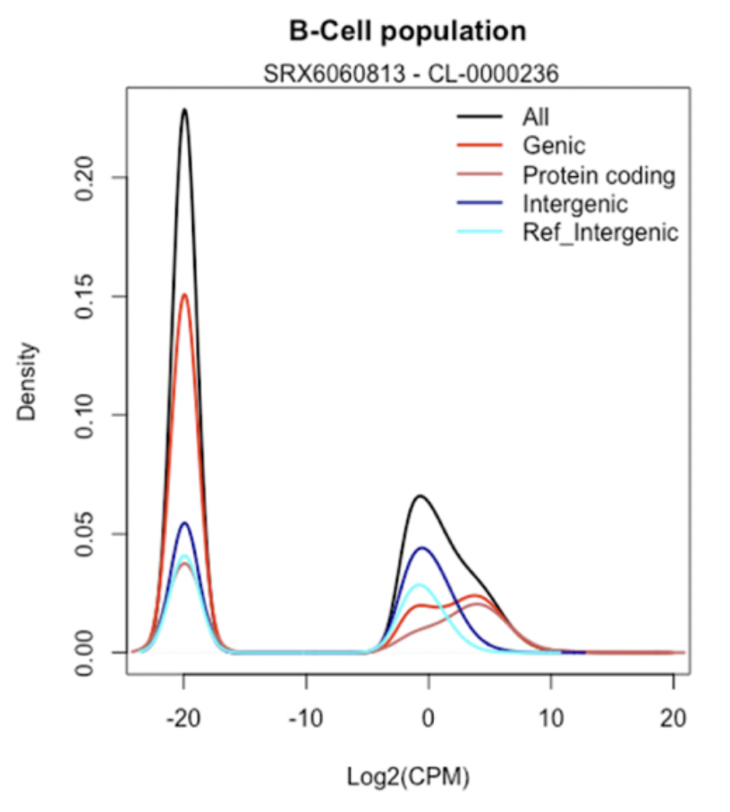
Single-cell RNA-Seq droplet-based
Perform calls at the level of the cell population
Then get back to individual cell
https://doi.org/10.1101/2022.03.31.486555
Notes:
read mapping to genic and intergenic regions -> normalize read counts to TPM -> estimate distribution of TPMs for intergenic regions -> compute zscore and p-values for each gene at each TPM level

Slide 25
All data types in Bgee
https://bgee.org/

Slide 26
P-values for all data types
Bulk RNA-Seq: Z-score in terms of standard deviations from the mean of reference intergenic regions, allows to compute a p-value
scRNA-Seq full-length: same
scRNA-Seq target-based: pull cells from a same cell type in an experiment, then same approach. Possibility to go back to individual cells

Slide 27
Propagation and reconciliation
https://bgee.org/
How expression information is used in the graph of conditions, and reconciled between data types and experiments

Slide 28
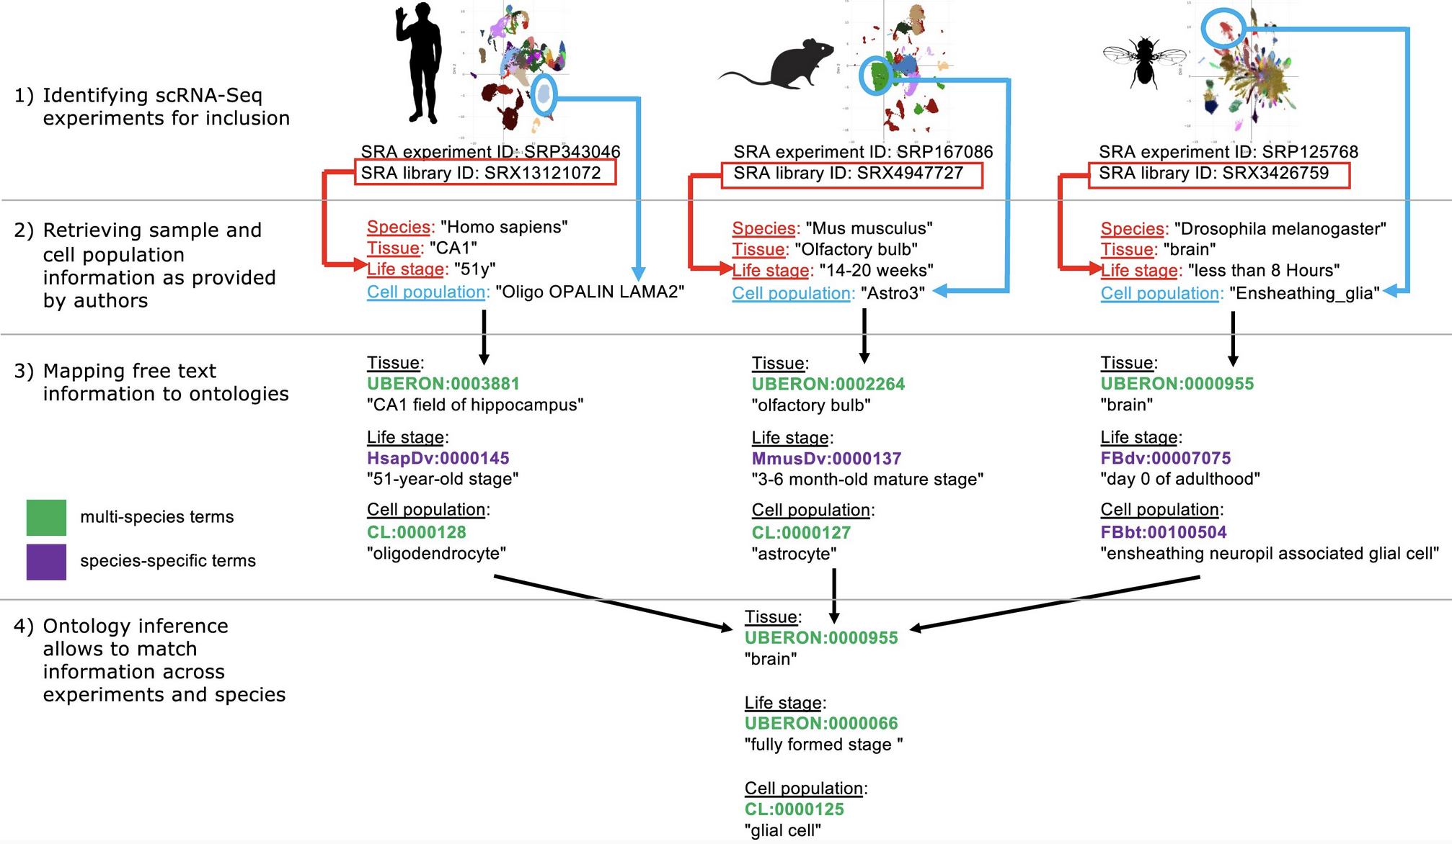
Expression information propagation

Slide 29
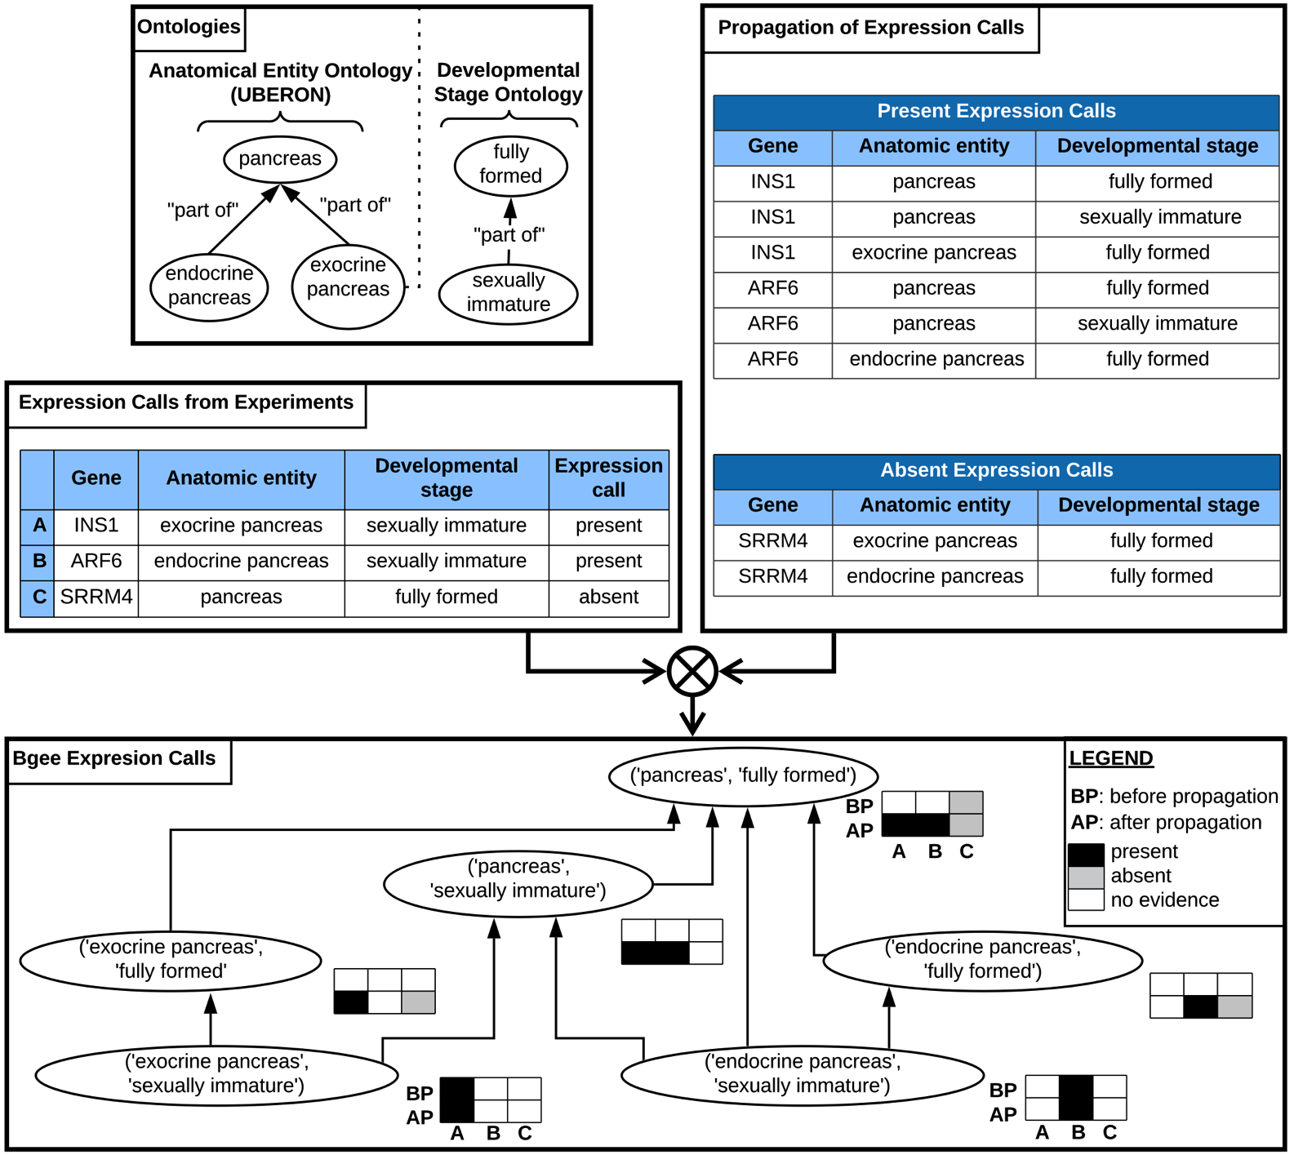
Expression information propagation

Slide 30
Expression information propagation

Slide 31
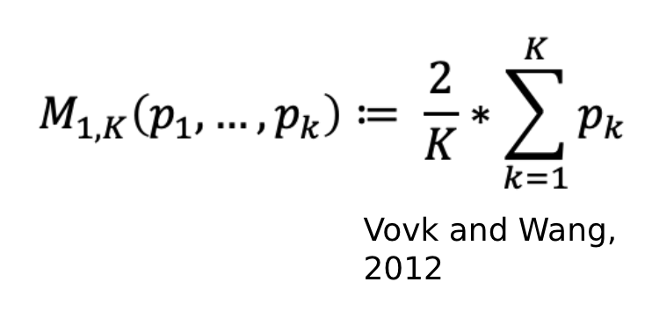
Integrating all p-values
Each p-value from each gene and sample is propagated along the graph of conditions
If the question we asked was: “is there any sample showing significant expression of the gene”
Or “In how many samples do we detect expression of the gene?”
=> then apply FDR correction to p-value
But the question we ask is rather: “from all the samples available, can we say that this gene is expressed in that condition?”
=> integrate all p-value information

Slide 32
Present/absent calls from integrated p-values
Present expression calls
Present gold: FDR p-value <= 0.01
Present silver: FDR p-value <= 0.05
Present bronze: FDR p-value > 0.05
best FDR p-value among sub-conditions <= 0.05
Absent expression calls
Absent gold: not present (see above)
FDR p-value > 0.1
At least one observation in the condition itself
Absent silver: not present (see above)
FDR p-value > 0.05
At least one observation in the condition itself
Absent bronze: not present (see above)
FDR p-value > 0.05 from less quantitative data types
At least one observation in the condition itself
Notes:
QUESTION AFTER THIS SLIDE

Slide 33
Expression ranks and expression scores
https://bgee.org/
Providing quantitative information on expression calls

Slide 34
Expression ranks
Present/absent expression calls are qualitative only
Missing quantitative information. But how to provide it when considering multiple data types and experiments?
=> Use of non-parametric statistics based on ranks

Slide 35
Expression ranks
For each data type, compute weighted mean ranks based on expression data.
Then normalize ranks between data types and condition to make them comparable.
Ranks are also propagated, taking into account all info in a condition and its sub-conditions

Slide 36
Expression score
We also transform these ranks into expression scores, more easily understandable by users:
higher gene expression translates into lower rank but higher expression score, from 0 to 100.
Notes:
QUESTION AFTER THIS SLIDE
Different experiments and techniques might have different power and resolution at ranking genes in a same condition. For instance, some in situ hybridization data might have allowed to rank 5 genes in a condition; while RNA-Seq data in the same condition might have allowed to rank 30,000 genes, with a max rank of 25,000, and 20,000 distinct ranks. The ranks from different experiments and data types can thus be highly heterogeneous, and difficult to compare as such. To overcome this limitation, we normalize ranks by taking into account the max rank for each data type, condition and species, as compared to the max rank over all data in this species. We thus normalize ranks by considering the average of their actual rank and their maximal shifted rank
While this will receive a low weight if there is more informative data (see below), it allows to compute a rank in the absence of other data type in this condition. It also avoids always ranking conditions studied only by in situ hybridization data at the top.

Slide 37
Finally...
https://bgee.org/
Example of results from expression calls and expression ranks

Slide 38

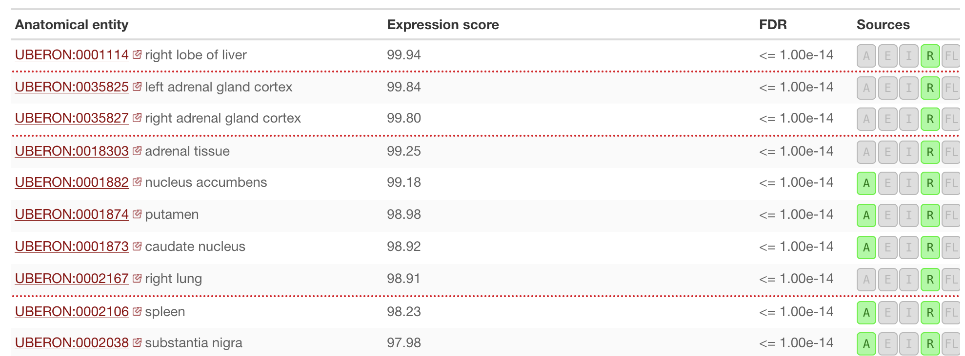
Example of Apoc1 gene
Calls of presence of expression

Slide 39
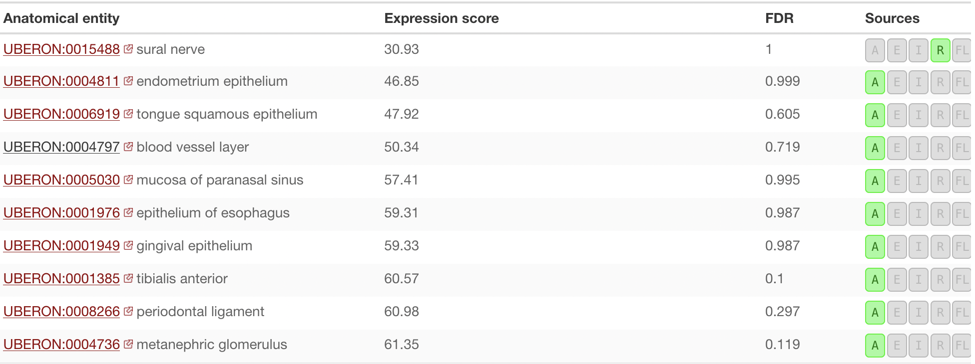
Example of Apoc1 gene
Calls of reported absence of expression

Slide 40








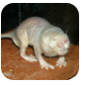





Example of Apoc1 gene

Slide 41














Example of Apoc1 gene

Slide 42
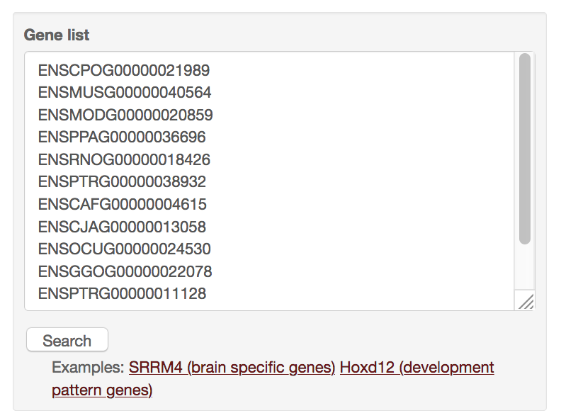
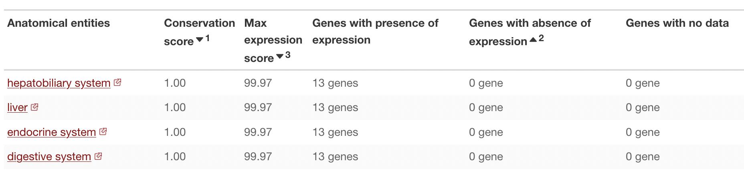
Example of Apoc1 gene
Expression comparison in Theria

Slide 43
Summary
To know the conditions where genes are expressed, Bgee performs manual and precise annotations to anatomy, development, sex, strains.
Integration of all data types and experiments by:
generation of p-values for each gene and sample
computation of expression ranks and scores for each gene and condition
propagation and integration of all the p-values
propagation of the expression ranks and scores and normalization

